Slide 1
Volunteer orientation
To turn the page, click anywhere on this slide, or swipe if you have a touch screen.

Slide 2
Welcome to our Catholic Charities team!
Thank you for donating your time and talents to help Catholic Charities of the Diocese of Green Bay. When you join our vibrant community, you become part of an international organization whose dedication, passion, and purpose make our Catholic Charities' outreach possible. In turn, we dedicate ourselves to ensuring you have a lifegiving experience with Catholic Charities. This orientation presentation is designed to get you started as a Catholic Charities volunteer. It will take about 20 minutes to complete and includes the following:
Mission, Vision, & History
Core values: Embrace, Nurture, Empower.
Volunteer Opportunities: Education, Events, Client relations.
Expectations: What we expect from our volunteers and what you can expect from us as we work together.
Client experience, Volunteer self-care & safety: Taking care of yourself and others anytime you volunteer with us.
Notes:
Tara – welcome and review of agenda
Introduce our theme
Reminder of our values embedded throughout
Anything else?

Slide 3
Our mission & vision
Volunteers play a vital role in helping us achieve our mission and vision:
Our Mission: We put our faith into action by strengthening individuals, families, and communities while reflecting the love of God through His Son, Jesus Christ.
Our Vision: We will be known as a trusted, faith-based social services partner providing hope to those in need in the 16 counties of the Diocese of Green Bay.

Slide 4
Our story

Slide 5
Our core values
Connect to Inspire – We are able to accomplish more together than we can on our own. The connection we have with God and others creates growth and excitement.
Embrace People's Hearts – Each person is created in the image and likeness of God and is deserving of respect and honor. All our interactions communicate the positive regard and appreciation we have for every person.
Explore Potential –We all have God-given potential. We work together to see the possibilities and the gifts each of us has been given in order to accomplish the vision and mission of the Church to evangelize and impact communities.
Empower to Act -All baptized Christians are empowered to act according to the gifts given to them by the Father, through the Son, in the Holy Spirit. By living out the diocesan vision and mission of missionary discipleship, we are empowered to take responsibility to act.
Nurture Abundant Life & Growth –Life is a gift, and we are charged by the Creator to protect it and to foster its growth wherever possible. We actively pursue life over death, potential over limitation, and light over darkness.

Slide 6
Why volunteer at Catholic charities?
Live out your faith
Make a difference
Gain confidence
Learn new skills
Experience for resume
Be part of a community

Slide 7
Refugee reception volunteers
Family Mentor
Move-in Team
Financial Team
Healthcare Team
Maintenance and Repair Team
Childcare Team

Slide 8
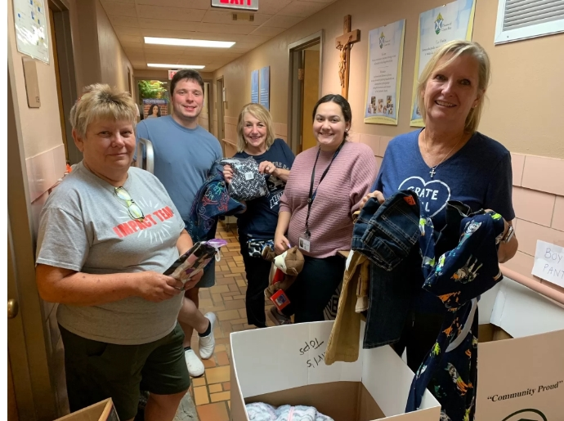
mentorship volunteers
Birthparent Mentor
Waiting Adoptive Family Mentor
Expectant Parent Mentor
Support Group Facilitator

Slide 9
Education Volunteers
Financial Health ASL (American Sign Language) Interpreter
Financial Health Spanish-English Interpreter
English Language Learner Teacher
Immigrant Rights Presenter
Client Translator and Interpreter

Slide 10
Events volunteers
Catholic Charities Event Representative
Inspired to Act Planning Committee
Event Success Team

Slide 11
Catholic charities parish ambassador
Be an active part of your church community
Communicate our mission
Attend community events and create brand awareness
Organize campaigns or volunteers in time of need through your church outreach

Slide 12
Getting Started as a Volunteer
Complete this online orientation.
Complete volunteer application.
After the approval of your application, background check and completing the VIRTUS training, you will meet with our Volunteer Coordinator either in person or by phone to discuss current volunteer opportunities.
Log in to your Track It Forward account, our volunteering website, to sign up for volunteer opportunities throughout the year.
If you have questions at any time, contact Halle Beranek, Volunteer Coordinator, at hberanek@gbdioc.org or (920)-272-8323

Slide 13
Volunteer expectations: What we expect from you
You will:
Actively perform your duties to the best of your abilities.
Arrive promptly for your volunteer hours.
Log your hours in Track It Forward
Inform the Volunteer Coordinator and your team supervisor if you need to cancel your shift as far in advance as possible.
Reflect our mission and core values in all that you do with Catholic Charities
Represent Catholic Charities with clients, staff, and other volunteers
Abide by Catholic Charities' policies and procedures

Slide 14
Volunteer expectation
If you're unable to make it for a volunteer shift, what should you do?
A) Go into Track It Forward and cancel your shift as soon as possible.
B) Inform the Volunteer Coordinator as soon as possible and he/she will pass it along to your volunteer supervisor.
C) Inform both the Volunteer Coordinator and your volunteer supervisor as far in advance as possible.
Correct answer: C By notifying both the Volunteer Coordinator and your volunteer supervisor, you'd help ensure that our Catholic Charities team is made aware of the change.
Knowledge Check

Slide 15
Volunteer expectations: What you can expect from us
We will:
Provide you with meaningful assignments.
Set you up for success with the proper training for your tasks.
Treat you as co-workers in a safe, welcoming environment.
Communicate effectively with you.
Value your input as a Catholic Charities team member.
Respect your time by being prepared for each volunteer shift.
Demonstrate our appreciation for the time and talent you share with Catholic Charities.

Slide 16
Get connected: Track It Forward
Volunteer opportunities are posted on Track It Forward, our online volunteer management system. Once your account has been set up, you can use Track It Forward to:
Sign up for volunteer opportunities.
Submit your volunteer hours and share notes on your experience online.
Stay up to date with the latest Catholic Charities events.
It's important to submit your volunteer hours after shifts. This data supports our work in grant applications and fundraising efforts, assessment of labor needs, and in evaluation of the effectiveness of our programs.
If you have questions about using Track It Forward, contact Halle Beranek, Volunteer Coordinator, at hberanek@gbdioc.org or (920)-272-8323

Slide 17
Get Connected:
Which is correct? Volunteers can use Track It Forward to:
A) Sign up for volunteer opportunities and log hours worked.
B) Find detailed job descriptions for volunteer areas.
C) Complete the onboarding process to become a Catholic Charities volunteer.
Correct answer: A Track It Forward lets you sign up for a variety of volunteer shifts online in different areas and record your hours throughout the year so we can see how many total hours you've dedicated to Catholic Charities.
Knowledge Check

Slide 18
Client Experience Tips
Be Welcoming Greet clients with a smile and offer to help.
Actively Listen Your face, voice, and body language show that you are actively listening.
Help Clients Provide help when you know the answer, but don't hesitate to find others for support when you don't know the answer.
Show Empathy Listen with empathy when others are having a difficult time, and don't take it personally. They may just need to vent.
Problems or Concerns: Go to staff members supervising your volunteer work or the Volunteer Coordinator so they can help resolve the issue rather than discussing it with others.

Slide 19
Client Experience Tips:
If a client approaches you with a question, and you don't know the answer, you should:
A) Tell them you don't know but will find someone who can assist them.
B) Suggest they go to the Catholic Charities website to find the answer.
C) Tell them to go to the front desk at Catholic Charities to find someone who knows the answer.
Correct answer: A It's okay if you don't know the answer to a client's question. Catholic Charities staff will be accessible to you and will know the answer or who to ask.
Knowledge Check

Slide 20
Volunteer self-Care
Self-care is essential when giving your time, talents, and skills to help others. Strengthen your volunteerism by:
Reading the volunteer position descriptions carefully to be sure that a role is a good fit for you physically, emotionally, and mentally.
Making sure you know the requirements of your positions and the potential risks.
If you have any concerns at any time, communicate them to your supervisor and/or the Volunteer Coordinator so they can assist you.

Slide 21
General safety
If you see something, say something! We don't expect volunteers to be trained to handle emergencies, but if you see something concerning, notify your supervisor at their direct line. (If there is an emergency, please call 911 before calling the numbers listed)
Please save these numbers on your phone for future reference:
Volunteer Coordinator (920)-272-8323
Catholic Charities front desk (920)-272-8234

Slide 22
General Safety:
What are the two phone numbers you should save to your phone in case of emergency?
A) Catholic Charities Executive Director and Volunteer Coordinator.
B) Volunteer Coordinator and 911
C) Volunteer Coordinator and Catholic Charities front desk
Correct answer: C It is important to call the Volunteer Coordinator and Catholic Charities front desk after contacting 911 in case of emergency to let them know the situation.
Knowledge Check

Slide 23
Safety: Injury or Accident
In case of a major injury or emergency, call 911 immediately!
If you, another volunteer, or someone else has a minor injury accident:
Notify your supervisor and the Volunteer Coordinator immediately.
Provide as much information about your location as possible.
Stay with the injured person until help arrives, if at all possible.

Slide 24
Safety: lost child/adult
In case of a major injury or emergency, call 911 immediately!
If a child is separated from a parent:
Stay with the child or parent.
Get help from the nearest staff member (or contact them via phone).
Continue to stay with the child or parent until help arrives.
This can be a very scary and stressful situation, but usually parents and children are quickly reunited. The same strategies apply for lost adults.

Slide 25
Volunteer testimonials
"[My] greatest delight comes from spending time with the children whether its tutoring or playing games-fostering a connection that feels like becoming a member of their family." -Sherry, volunteer with Afghan families
On his role helping financial health presentations, "The project is pretty independent, and I can do it at remotely home." -Carl, financial health volunteer

Slide 26
“putting our faith into action”
Thank you!
for completing our online orientation! The next step is to submit the online volunteer application and background check. We look forward to welcoming you to our Catholic Charities team!
catholiccharitiesgb.org

